Slide 1
ARM PROCESSOR

Slide 2
8051 VS ARM
8051 | ARM
8 bit for standard core bus width is present in 8051 micro-controller. | Mostly 32bit bus width is present in ARM micro-controller and also 64-bit is available.
Its speed is 12 clock cycles per machine cycle. | Its speed is 1 clock cycle per machine cycle.
is based on CISC Instruction set Architecture. | It is based on RISC Instruction Set Architecture.
8051 micro-controller is a Harvard-based architecture, but it allows us to connect external memory and simulate von Neumann’s architecture. | ARM micro-controller is based on Harvard architecture.
Power consumption of 8051 micro-controller is average. | Power consumption of ARM micro-controller is low.
Its manufacturers are Atmel, NXP, Silicon Labs, Dallas, Cyprus, Infineon, etc. | Its manufacturers are Nvidia, Qualcomm, Apple, Samsung Electronics, and TI etc.
Popular micro-controllers include AT89C51, P89v51, etc. | Popular micro-controllers include ARM Cortex-M0 to ARM Cortex-M7, etc.

Slide 3
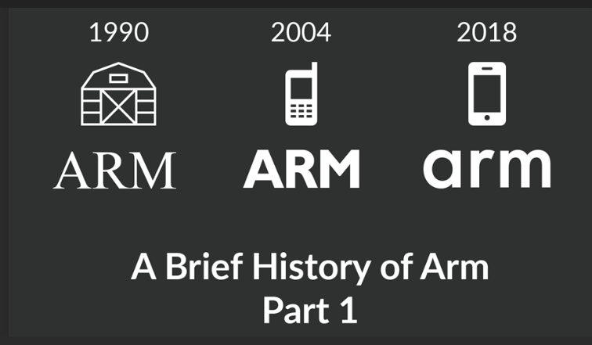
BRIEF OF ARM

Slide 4
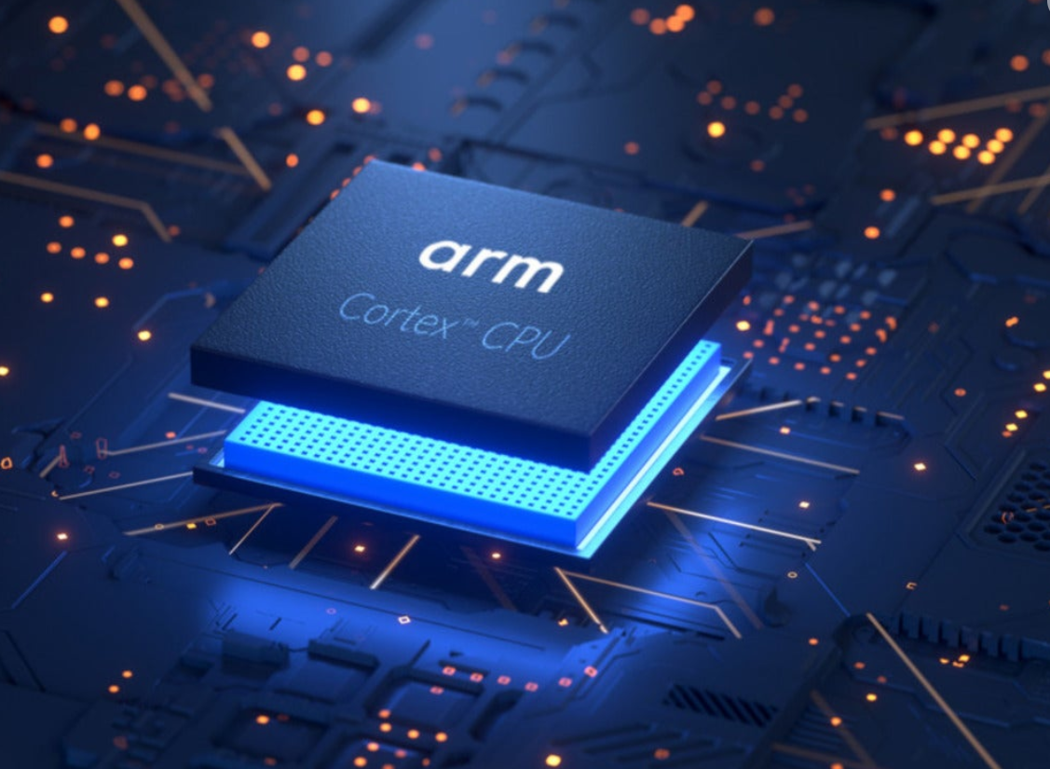
LATEST PIC OF ARM

Slide 5
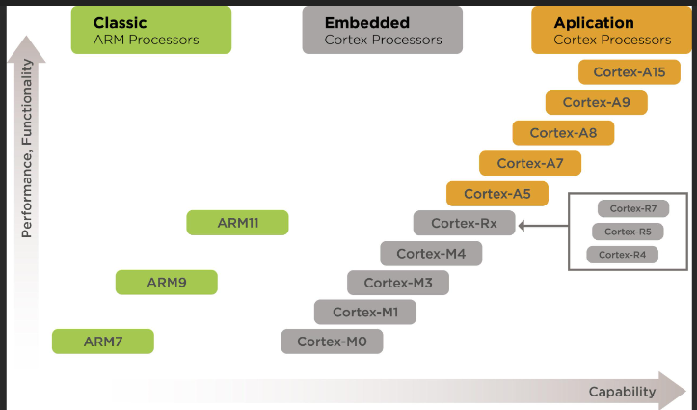
Cortex M55, M85, and M52

Slide 6
FEATURES OF ARM
Advanced RISC Machine (ARM) Processor is considered to be a family of Central Processing Units that are used in music players, smartphones, wearables, tablets, and other consumer electronic devices.
Advanced RISC Machines create the ARM processor architecture, hence the name ARM. This needs very few instruction sets and transistors. It has very small in size. This is the reason that it is a perfect fit for small-size devices. It has less power consumption along with reduced complexity in its circuits.
They can be applied to various designs such as 32-bit devices and embedded systems. They can even be upgraded according to user needs

Slide 7
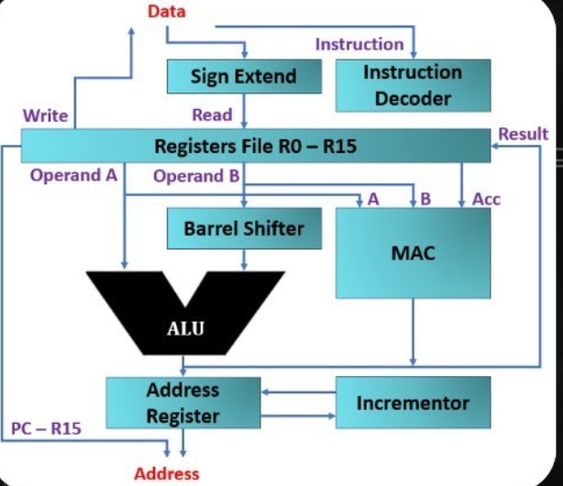
ARM ARCHITECTURE
Executes operations
Load
Store

Slide 8
ARM OPERATIONS
Arithmetic Logic Unit
all logical operations
MAC
Multilply and accumulate
Barrel shifter
This field indicates the kind of shift to be performed (logical left or right, arithmetic right or rotate right). The quantity by which the register ought to be shifted is contained in an immediate field within the instruction or it might be the lower 6 bits of a register within the register file.

Slide 9
Control unit
For any microprocessor, control unit is the heart of the whole process and it is responsible for the system operation, so the control unit design is the most important part within the whole design. The control unit is sometimes a pure combinational circuit design. Here, the control unit is implemented by easy state machine. The processor timing is additionally included within the control unit. Signals from the control unit are connected to each component within the processor to supervise its operation.

